Slide 1
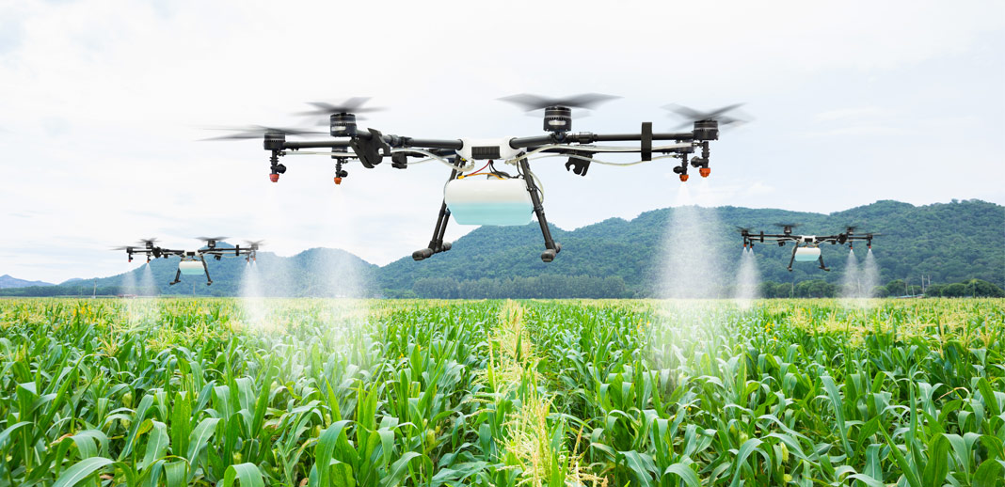
AGRIDRONE AUTOMATION OF AGRICULTURE USING IoT
Presented By :
Palle Manjunath(U18EC135), Karanam Venkata Veera Brahmaiah(U18EC134),
Bollapu Hemanth Kumar Reddy(U18EC129)

Slide 2
CONTENT
INTRODUCTION
AUTOMATION
AGRICLTURE AUTOMATION
NEEDS OF AUTOMATION
PROGRAM FOR ROBOTS
WORKING OF ROBOTS
FOOD SHORTAGE, BIG BUSINESS
PRECISION PRUNING
ROBOT LETTUCE
DRONE MONITORS
FUTURE TRENDS IN AUTOMATION
ADVANTAGES
DISADVANTAGES

Slide 3
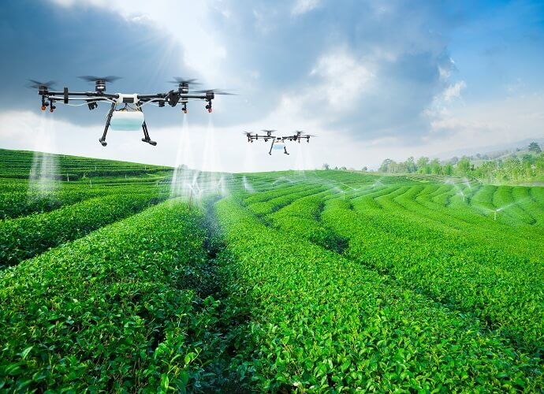
INTRODUCTION
An agriculture drone is an unmanned aerial
vehicle used to help optimize agriculture
operations, increase crop production, and
monitor crop growth.
Sensors & digital imaging
capabilities can give farmers a richer
pictures of their fields.
Using an agriculture drone and gathering
information from it may prove useful in
improving crop yields and farm efficiency.

Slide 4
AUTOMATION
The work is done by robot without any man power.
Automation is used in all fields eg ; automobiles , manufacturing fields.
Automation is a illumination afford from the working field.
Recently automation is used in agriculture.
Major work in agriculture are done with the help of automation.
Pesticide spraying , dropping the seeds , ploughing , providing water to crop.

Slide 5
AGRICULTURE AUTOMATION
Agriculture robot or agribot deployed for agriculture purposes.
Fruits picking robots , driverless tractor/sprayer, and sheep shearing robots.
Pruning , weeding , spraying and monitors of orchids.
Livestock application , Automatic milking , washing.
Less needs for labour work.

Slide 6
NEEDS OF AUTOMATION
Automation in agriculture is very necessary because of firstly by the year 2042, the world population is projected to increase to 9 billion souls.
Secondly with traditional method of agriculture some drawbacks like wastage of seed, improper spraying of pesticide on crop so soil standard get degrades also food become harmful to human body.
In order to overcome all the above drawbacks of tradition agriculture and to become the agriculture field modern , hi-tech and fastest growing.

Slide 7
Lack of man power.
For maintaining uniformity.
Mechanization and automation in agriculture fields improves the productivity.
Water irrigation methods like trip, springler, by automation reduces the utilization of water.
By automation processes crop calendar is maintained.

Slide 8
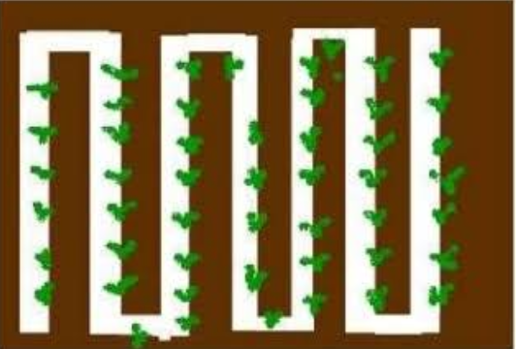
PROGRAM FOR ROBOTS
Designing automatic system we provide tracking through the white line following robot concept in which the robot distinguishes white and black or dark surface and follows only white track.
To this concept we are going to implement a white line on a farm where actually we need to work & remaining surface is treated as a black surface due to the brownish colour of soil.
Farm Area
Crop
Robotic Path

Slide 9
WORKING OF ROBOTS
We provide delay to robot at equal distance to do the agriculture work like pesticide spraying, water supplying, plugging, dropping of seed, accurately and automatically.
The pesticide liquid which is contain by a tank is came through the rubber pipe to the tip of DC motor, at that shaft of motor a fan blade is attach, which revolves at the delay time of robot or on front of crop.
Due to revolution the liquid get spray on crop.

Slide 10
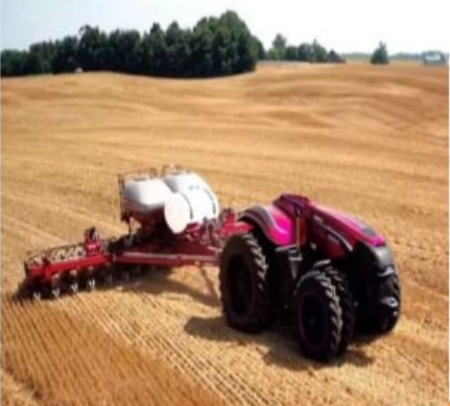
FOOD SHORTAGES , BIG BUSINESS
The World Bank says we’ll need to produce 50% more food by 2050 if the global population continues to rise at its current pace.
But the effects of climate change could see crop yields falling by more than a quarter.
So autonomous tractors, ground-based sensors, flying drones and enclosed hydroponic farms could all help farmers produce more food, more sustainably at lower cost.

Slide 11
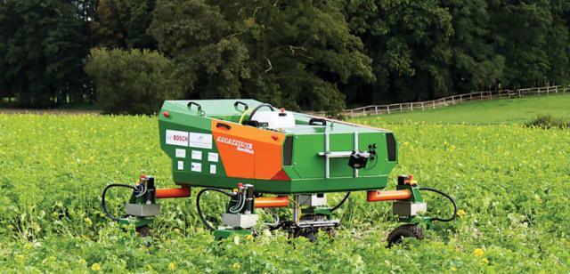
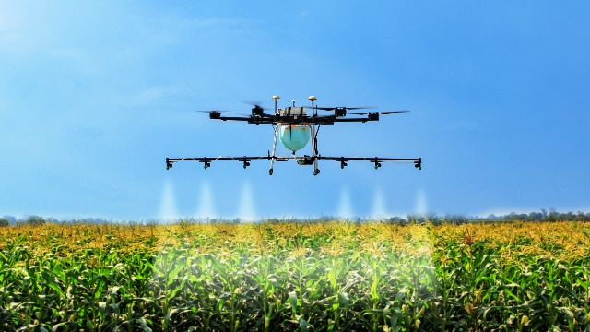
AUTOMATION APPLICATIONS

Slide 12
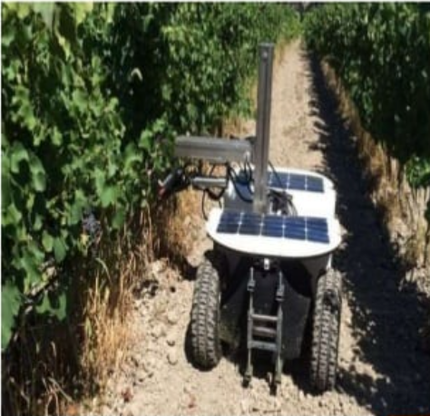
PRECISION PRUNING
But even here automation is encroaching.
Wine makers have used drones to inspect their vineyards for several years, with high-defination cameras and sensors assessing crop and soil health.
But in France’s Burgundy region, a shortage of farm labour has led inventor Christophe Millot to develop a vine-pruning robot called Wall-Ye.

Slide 13
The machine learns as it goes and can trim the grass around each vine. An onboard solar-powered battery gives 10-12 hours of charge, so with a change of battery, it can work day and night.
Visual recognition is the biggest challenge, says Mr Millot - knowing where to make the cut. This is actually easier at night, because the robot’s lights can illuminate the plant, but not its background.

Slide 14
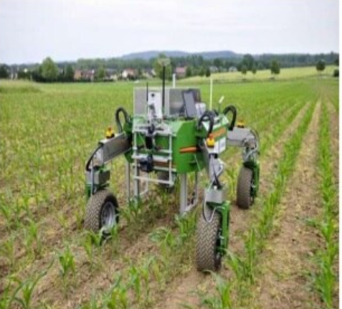
ROBOT LETTUCE
Japanese firm Spread’s automated vegetable factory in Kyoto, due to launch next year, could produce 30,000 lettuces a day.
It streches up, instead of across undulcating fields, because “in countries like Japan, where land is actually a very scarce resource, it makes more sense to stack your production.

Slide 15
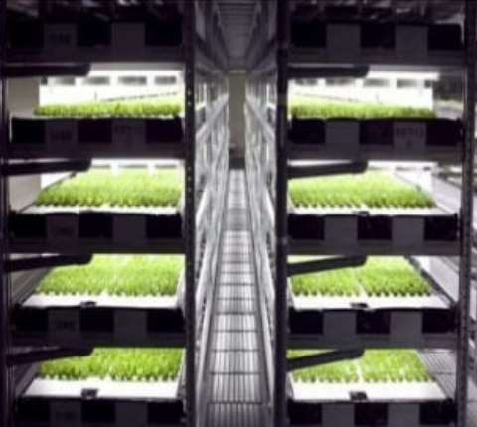
After seeding will be done by machines - watering, trimming , harvesting - on shelves stacked from floor to ceiling.
Automation has reduced labour costs by 50% says Mr Price. And LED ligthing developed specifically for plant cultivation reduces energy costs by 30%. And growing vegetables in vertical farms means you can recycle 98% of the water.

Slide 16
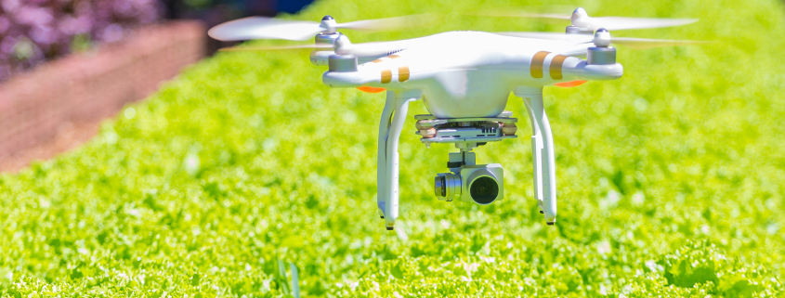
DRONE MONITORS
Back outside, drones are monitoring crop growth rates, spotting disease, and even spraying crops with pesticides and herbicides.
Although GPS signals are generally strong in agricultural areas, one challenge for drones and other farmland robots is copying with patchy internet and mobile connectivity.

Slide 17
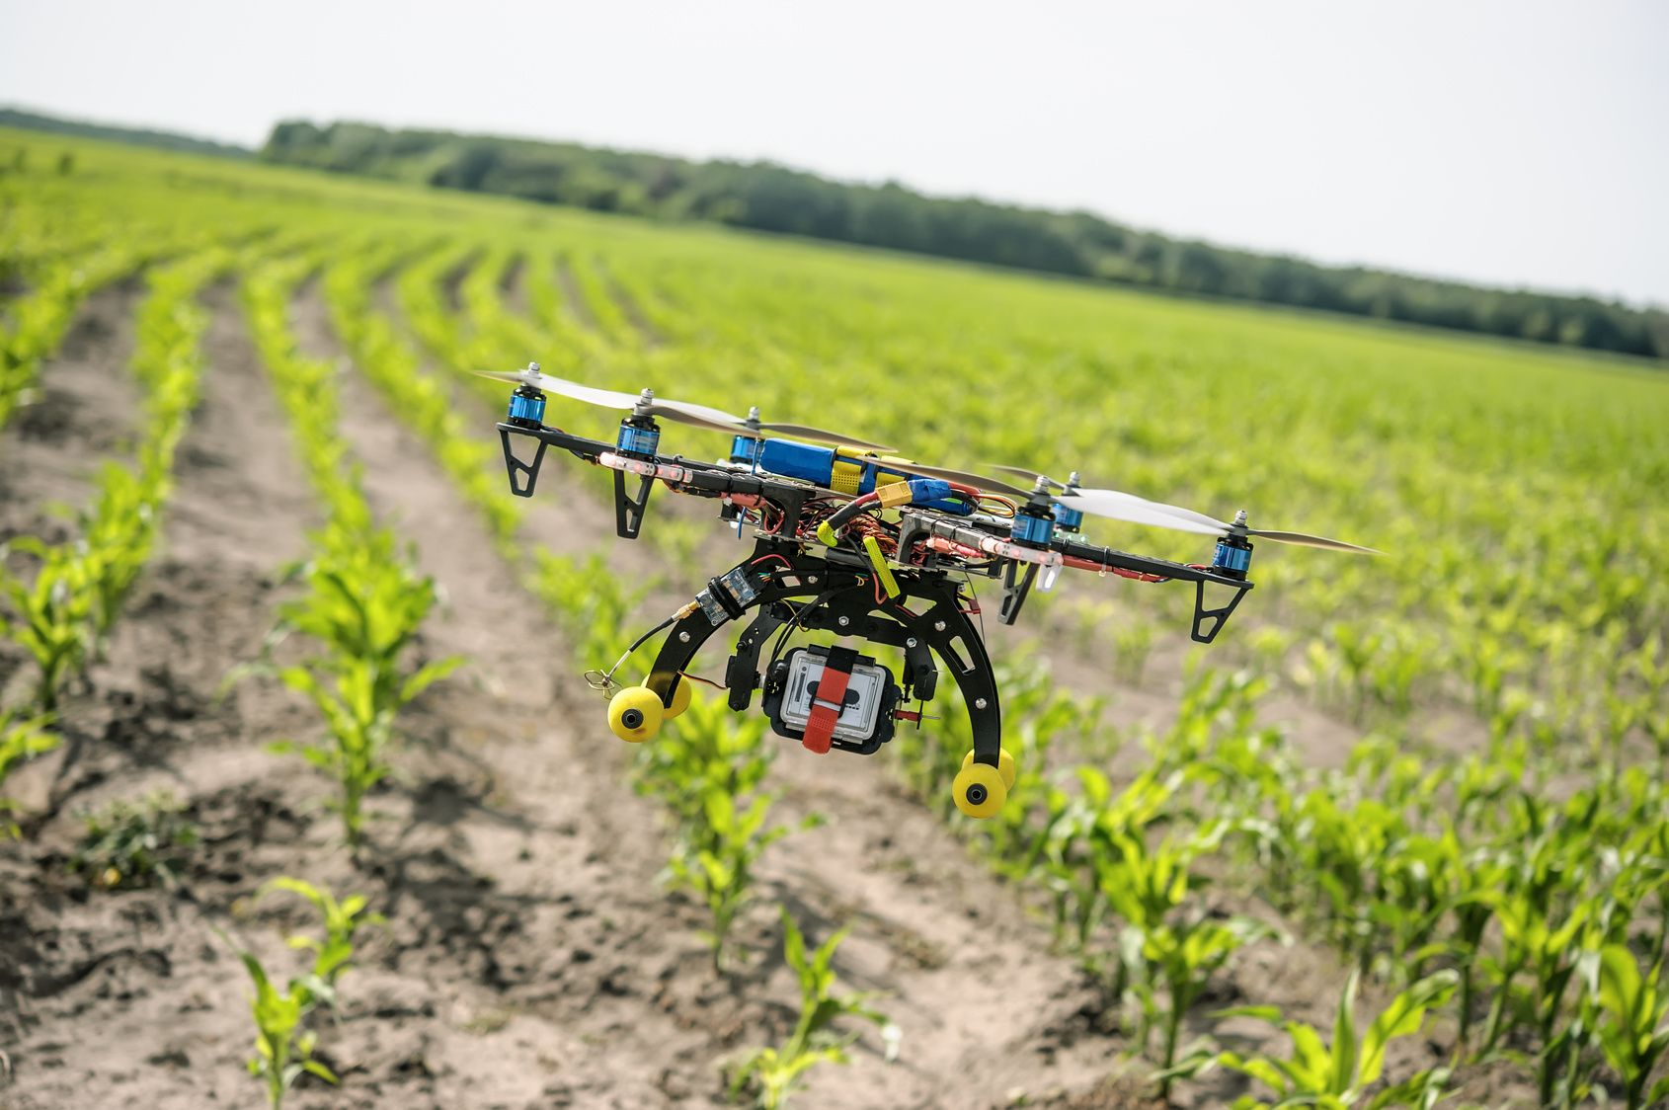
So Dr Trianni’s team is using ultra-wideband radio for his drones to communicate without relying on rural 3G or 4G mobile connections.
From 1950 to 2010, according to the International Labour Organization(ILO), agricultural labourers as a percentages of the workforce declined from 81% to 48.2% in developing countries, and from 35% to 4.2% in developed ones.

Slide 18
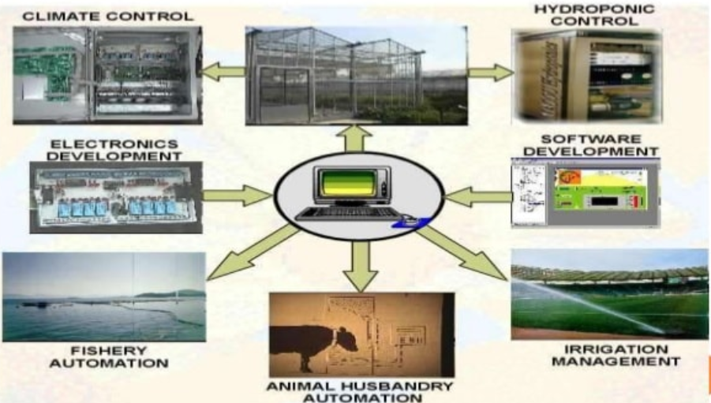
FUTURE TRENDS IN AUTOMATION

Slide 19
ADVANTAGES
Eco friendly.
Reduces human efforts.
Improves the productivity.
Uniformity of work.
Reduce the production cost.
Less operating cost.

Slide 20
DISADVANTAGES
High initial cost.
Requires knowledge about robot for operators.
Reducing job opportunituies.
High maintenance cost.
Suitable for farming in large areas.

Slide 21


